Slide 1


Slide 2
DEEP LEARNING COURSE
FALL 2026
Usman Khan, PhD

Slide 3
PRAYERS BREAK till 1850 / 0650 PM

Slide 4
KNOW YOUR DATA FIRST
What are the types of attributes or fields that make up your data?
What kind of values does each attribute have?
Which attributes are discrete, and which are continuous-valued?
What do the data look like?
How are the values distributed?
Are there ways we can visualize the data to get a better sense of it all?
Can we spot any outliers?
Can we measure the similarity of some data objects with respect to others?
Gaining such insight into the data will help with the subsequent analysis
Notes:
Initially, the weights of the network are assigned random values, so the network merely implements a series of random transformations. Naturally, its output is far from what it should ideally be, and the loss score is accordingly very high. But with every example the network processes, the weights are adjusted a little in the correct direction, and the loss score decreases. This is the training loop, which, repeated a sufficient number of times (typically tens of iterations over thousands of examples), yields weight values that minimize the loss function.

Slide 5
ATTRIBUTES TYPES
NOMINAL ATTRIBUTES
Nominal attribute are symbols or names of things. Each value represents some kind of category, code, or state, and so nominal attributes are also referred to as categorical.
Example: Suppose that hair color and marital status are two attributes describing person objects. The attribute marital status can take on the values single, married, divorced, and widowed. Both hair color and marital status are nominal attributes
Because nominal attribute values do not have any meaningful order about them and are not quantitative, it makes no sense to find the mean (average) value or median (middle) value. The attribute’s most commonly occurring value known as the mode, is one of the measures of central tendency.
Notes:
Initially, the weights of the network are assigned random values, so the network merely implements a series of random transformations. Naturally, its output is far from what it should ideally be, and the loss score is accordingly very high. But with every example the network processes, the weights are adjusted a little in the correct direction, and the loss score decreases. This is the training loop, which, repeated a sufficient number of times (typically tens of iterations over thousands of examples), yields weight values that minimize the loss function.

Slide 6
ATTRIBUTES TYPES
BINARY ATTRIBUTES
A binary attribute is a nominal attribute with only two categories or states: 0 or 1, where 0 typically means that the attribute is absent, and 1 means that it is present. Binary attributes are referred to as Boolean if the two states correspond to true and false.
Example. Given the attribute smoker describing a patient object, 1 indicates that the patient smokes, while 0 indicates that the patient does not.
A binary attribute is symmetric if both of its states are equally valuable and carry the same weight; that is, there is no preference on which outcome should be coded as 0 or 1. One such example could be the attribute gender having the states male and female
A binary attribute is asymmetric if the outcomes of the states are not equally important, such as the positive and negative outcomes of a medical test for HIV
Notes:
Initially, the weights of the network are assigned random values, so the network merely implements a series of random transformations. Naturally, its output is far from what it should ideally be, and the loss score is accordingly very high. But with every example the network processes, the weights are adjusted a little in the correct direction, and the loss score decreases. This is the training loop, which, repeated a sufficient number of times (typically tens of iterations over thousands of examples), yields weight values that minimize the loss function.

Slide 7
ATTRIBUTES TYPES
ORDINAL ATTRIBUTES
An ordinal attribute is an attribute with possible values that have a meaningful order or ranking among them, but the magnitude between successive values is not known.
Example: Suppose that drink size corresponds to the size of drinks available at a fast-food restaurant. This nominal attribute has three possible values: small, medium, and large
Customer satisfaction had the following ordinal categories: 0: very dissatisfied, 1: somewhat dissatisfied, 2: neutral, 3: satisfied, and 4: very satisfied.

Slide 8
ATTRIBUTES TYPES
NUMERICAL ATTRIBUTES
A numeric attribute is quantitative; that is, it is a measurable quantity, represented in integer or real values. Numeric attributes can be interval-scaled or ratio-scaled.
Interval-scaled attributes are measured on a scale of equal-size units. The values of interval-scaled attributes have order and can be positive, 0, or negative. Thus, in addition to providing a ranking of values, such attributes allow us to compare and quantify the difference between values.
A temperature attribute is interval-scaled. For example, a temperature of 20◦C is five degrees higher than a temperature of 15◦C.
Without a true zero, we cannot say, for instance, that 10◦C is twice as warm as 5◦C. That is, we cannot speak of the values in terms of ratios.
Notes:
Initially, the weights of the network are assigned random values, so the network merely implements a series of random transformations. Naturally, its output is far from what it should ideally be, and the loss score is accordingly very high. But with every example the network processes, the weights are adjusted a little in the correct direction, and the loss score decreases. This is the training loop, which, repeated a sufficient number of times (typically tens of iterations over thousands of examples), yields weight values that minimize the loss function.

Slide 9
ATTRIBUTES TYPES
NUMERICAL ATTRIBUTES
Ratio Scaled: Unlike temperatures in Celsius and Fahrenheit, the Kelvin (K) temperature scale has what is considered a true zero-point (0◦K = −273.15◦C) It is the point at which the particles that comprise matter have zero kinetic energy. Other examples of ratio-scaled attributes include count attributes such as years of experience (e.g., the objects are employees) and number of words (e.g., the objects are documents), monetary quantities (e.g., you are 100 times richer with $100 than with $1).
Notes:
Initially, the weights of the network are assigned random values, so the network merely implements a series of random transformations. Naturally, its output is far from what it should ideally be, and the loss score is accordingly very high. But with every example the network processes, the weights are adjusted a little in the correct direction, and the loss score decreases. This is the training loop, which, repeated a sufficient number of times (typically tens of iterations over thousands of examples), yields weight values that minimize the loss function.

Slide 10
ATTRIBUTES TYPES
DISCRETE ATTRIBUTES
Classification algorithms developed from the field of machine learning often talk of attributes as being either discrete or continuous. Each type may be processed differently. A discrete attribute has a finite or countably infinite set of values, which may or may not be represented as integers. The attributes hair color, smoker, medical test, and drink size each have a finite number of values, and so are discrete. Note that discrete attributes may have numeric values, such as 0 and 1 for binary attributes or, the values 0 to 110 for the attribute age. An attribute is countably infinite if the set of possible values is infinite but the values can be put in a one-to-one correspondence with natural numbers. For example, the attribute customer ID is countably infinite.
Notes:
Initially, the weights of the network are assigned random values, so the network merely implements a series of random transformations. Naturally, its output is far from what it should ideally be, and the loss score is accordingly very high. But with every example the network processes, the weights are adjusted a little in the correct direction, and the loss score decreases. This is the training loop, which, repeated a sufficient number of times (typically tens of iterations over thousands of examples), yields weight values that minimize the loss function.

Slide 11
ATTRIBUTES TYPES
CONTINOUS ATTRIBUTES
In practice, real values are represented using a finite number of digits. Continuous attributes are typically represented as floating-point variables.
Notes:
Initially, the weights of the network are assigned random values, so the network merely implements a series of random transformations. Naturally, its output is far from what it should ideally be, and the loss score is accordingly very high. But with every example the network processes, the weights are adjusted a little in the correct direction, and the loss score decreases. This is the training loop, which, repeated a sufficient number of times (typically tens of iterations over thousands of examples), yields weight values that minimize the loss function.

Slide 12

BASIC STATISTICAL DESCRIPTION OF DATA
Two important statistical parameters in Machine Learning and Deep learning as well are:-
Central Tendency
Dispersion
Center Tendency
Mean
$$x^{−}=\frac{∑x_{i}}{N};i=0:N−1$$
Weighted Mean
$$x^{−}=\frac{∑w_{i}x_{i}}{∑w_{i}} ;i=0:N−1$$
Notes:
Initially, the weights of the network are assigned random values, so the network merely implements a series of random transformations. Naturally, its output is far from what it should ideally be, and the loss score is accordingly very high. But with every example the network processes, the weights are adjusted a little in the correct direction, and the loss score decreases. This is the training loop, which, repeated a sufficient number of times (typically tens of iterations over thousands of examples), yields weight values that minimize the loss function.

Slide 13
BASIC STATISTICAL DESCRIPTION OF DATA
A major problem with the mean is its sensitivity to extreme (e.g., outlier) values. Even a small number of extreme values can corrupt the mean. For example, the mean salary at a company may be substantially pushed up by that of a few highly paid managers
In such cases the solution can be trimmed Mean i-e chopping of 2% of the data at the top/ bottom to remove outliers
Notes:
Initially, the weights of the network are assigned random values, so the network merely implements a series of random transformations. Naturally, its output is far from what it should ideally be, and the loss score is accordingly very high. But with every example the network processes, the weights are adjusted a little in the correct direction, and the loss score decreases. This is the training loop, which, repeated a sufficient number of times (typically tens of iterations over thousands of examples), yields weight values that minimize the loss function.

Slide 14
BASIC STATISTICAL DESCRIPTION OF DATA
from sklearn.preprocessing import StandardScaler
import numpy as np
data = np.array([[1, 2, 3],
[4, 5, 6],
[7, 8, 9]])
scaler = StandardScaler()
scaler.fit(data)
means = scaler.mean_
print(f"the mean of each column {means}")
the mean of each column [4. 5. 6.]
Notes:
Initially, the weights of the network are assigned random values, so the network merely implements a series of random transformations. Naturally, its output is far from what it should ideally be, and the loss score is accordingly very high. But with every example the network processes, the weights are adjusted a little in the correct direction, and the loss score decreases. This is the training loop, which, repeated a sufficient number of times (typically tens of iterations over thousands of examples), yields weight values that minimize the loss function.

Slide 15
BASIC STATISTICAL DESCRIPTION OF DATA
import tensorflow as tf
data = tf.constant([[1.0,2.0,3.0],
[4.0,5.0,6.0],
[7.0,8.0,9.0]
])
means_complete = tf.reduce_mean(data)
Tensorflow based mean of complete array 5.0
Self Study : Get the Mean of the data matrix column & row wise
Notes:
Initially, the weights of the network are assigned random values, so the network merely implements a series of random transformations. Naturally, its output is far from what it should ideally be, and the loss score is accordingly very high. But with every example the network processes, the weights are adjusted a little in the correct direction, and the loss score decreases. This is the training loop, which, repeated a sufficient number of times (typically tens of iterations over thousands of examples), yields weight values that minimize the loss function.

Slide 16
BASIC STATISTICAL DESCRIPTION OF DATA
import tensorflow as tf
# Create a sample matrix (tensor)
data = tf.constant([[1.0, 2.0, 3.0],
[4.0, 5.0, 6.0],
[7.0, 8.0, 9.0]])
# Create weights (same shape as data or compatible for broadcasting)
weights = tf.constant([[0.1, 0.2, 0.3],
[0.2, 0.1, 0.3],
[0.3, 0.3, 0.1]])
# Multiply the data by the weights
weighted_data = data * weights
# Compute the sum of weighted values
weighted_sum = tf.reduce_sum(weighted_data)
# Compute the sum of the weights (to normalize the result)
sum_weights = tf.reduce_sum(weights)
# Compute the weighted average
weighted_average = weighted_sum / sum_weights
# Print the result
print(f"Weighted average of the matrix: {weighted_average.numpy()}")
Self Study : Get the Mean of the data matrix column & row wise
Notes:
Initially, the weights of the network are assigned random values, so the network merely implements a series of random transformations. Naturally, its output is far from what it should ideally be, and the loss score is accordingly very high. But with every example the network processes, the weights are adjusted a little in the correct direction, and the loss score decreases. This is the training loop, which, repeated a sufficient number of times (typically tens of iterations over thousands of examples), yields weight values that minimize the loss function.

Slide 17
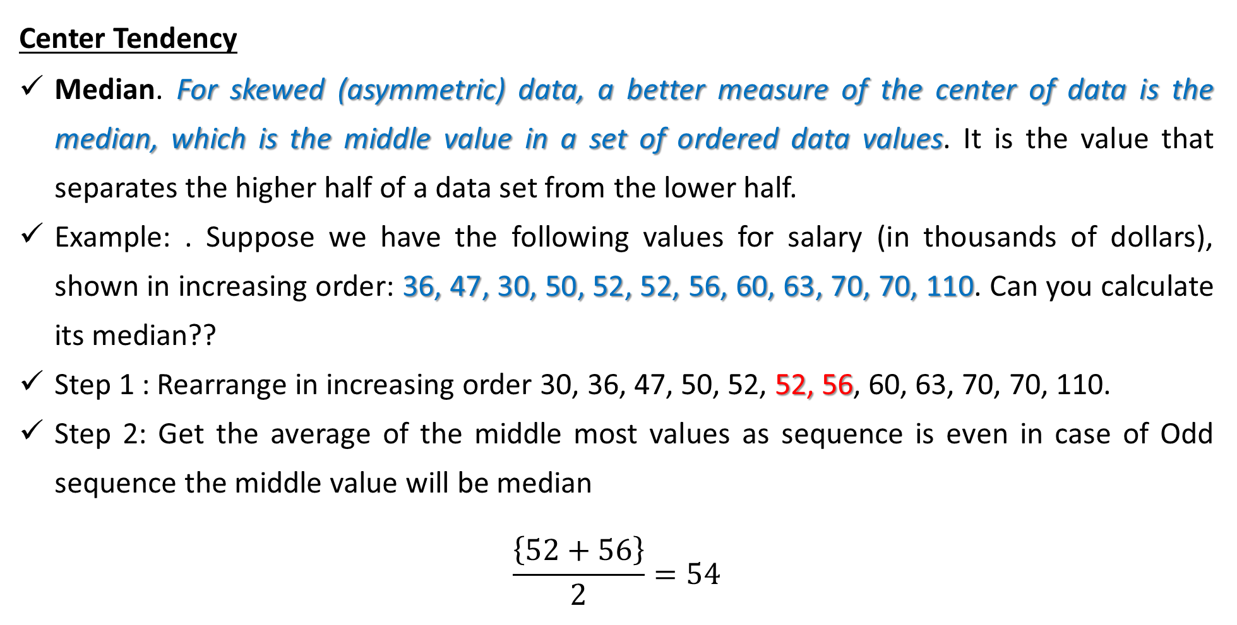
BASIC STATISTICAL DESCRIPTION OF DATA
Center Tendency
Median. For skewed (asymmetric) data, a better measure of the center of data is the median, which is the middle value in a set of ordered data values. It is the value that separates the higher half of a data set from the lower half.
Example: . Suppose we have the following values for salary (in thousands of dollars), shown in increasing order: 36, 47, 30, 50, 52, 52, 56, 60, 63, 70, 70, 110. Can you calculate its median??
Step 1 : Rearrange in increasing order 30, 36, 47, 50, 52, 52, 56, 60, 63, 70, 70, 110.
Step 2: Get the average of the middle most values as sequence is even in case of Odd sequence the middle value will be median
$$\frac{\left\{52+56\right\}}{2}=54$$
Notes:
Initially, the weights of the network are assigned random values, so the network merely implements a series of random transformations. Naturally, its output is far from what it should ideally be, and the loss score is accordingly very high. But with every example the network processes, the weights are adjusted a little in the correct direction, and the loss score decreases. This is the training loop, which, repeated a sufficient number of times (typically tens of iterations over thousands of examples), yields weight values that minimize the loss function.

Slide 18
BASIC STATISTICAL DESCRIPTION OF DATA
Center Tendency
Mode. The mode for a set of data is the value that occurs most frequently in the set.
Data sets with one, two, or three modes are respectively called unimodal, bimodal, and trimodal. In general, a data set with two or more modes is multimodal
Quiz 1 - Mind Boggler:
f = [30, 36, 47, 50, 52, 52, 56, 60, 63, 70, 70, 110]
Write the Mode in the dataset
Let us have a weights array w = [0.1, 1, 2, 0.1, 0.1, 1, 2, 0.1, 0.1, 1, 2, 0.1]
Can you calculate the weighted Mean of the array f
Notes:
Initially, the weights of the network are assigned random values, so the network merely implements a series of random transformations. Naturally, its output is far from what it should ideally be, and the loss score is accordingly very high. But with every example the network processes, the weights are adjusted a little in the correct direction, and the loss score decreases. This is the training loop, which, repeated a sufficient number of times (typically tens of iterations over thousands of examples), yields weight values that minimize the loss function.

Slide 19
BASIC STATISTICAL DESCRIPTION OF DATA
Center Tendency
For unimodal numeric data that are moderately skewed (asymmetrical), we have the empirical relation: mean − mode ≈ 3 × (mean − median).
This implies that the mode for unimodal frequency curves that are moderately skewed can easily be approximated if the mean and median values are known. The midrange can also be used to assess the central tendency of a numeric data set. It is the average of the largest and smallest values in the set
Notes:
Initially, the weights of the network are assigned random values, so the network merely implements a series of random transformations. Naturally, its output is far from what it should ideally be, and the loss score is accordingly very high. But with every example the network processes, the weights are adjusted a little in the correct direction, and the loss score decreases. This is the training loop, which, repeated a sufficient number of times (typically tens of iterations over thousands of examples), yields weight values that minimize the loss function.

Slide 20
BASIC STATISTICAL DESCRIPTION OF DATA
# Calculate the number of elements
n_elements = tf.size(sorted_data)
# If the number of elements is odd, the median is the middle element
# If it's even, the median is the average of the two middle elements
is_odd = tf.math.mod(n_elements, 2)
# Get the middle index
middle_index = n_elements // 2
# Conditional logic to handle odd and even cases
median = tf.cond(is_odd > 0,
lambda: sorted_data[middle_index],
lambda: (sorted_data[middle_index - 1] + sorted_data[middle_index]) / 2)
# Print the median
print(f"Median of the matrix: {median.numpy()}")
import tensorflow as tf
# Create a sample tensor (matrix)
data = tf.constant([[1.0, 2.0, 3.0],
[4.0, 5.0, 6.0],
[7.0, 8.0, 9.0]])
# Flatten the matrix to a 1D tensor
flattened_data = tf.reshape(data, [-1])
# Sort the flattened tensor
sorted_data = tf.sort(flattened_data)
Notes:
Initially, the weights of the network are assigned random values, so the network merely implements a series of random transformations. Naturally, its output is far from what it should ideally be, and the loss score is accordingly very high. But with every example the network processes, the weights are adjusted a little in the correct direction, and the loss score decreases. This is the training loop, which, repeated a sufficient number of times (typically tens of iterations over thousands of examples), yields weight values that minimize the loss function.

Slide 21
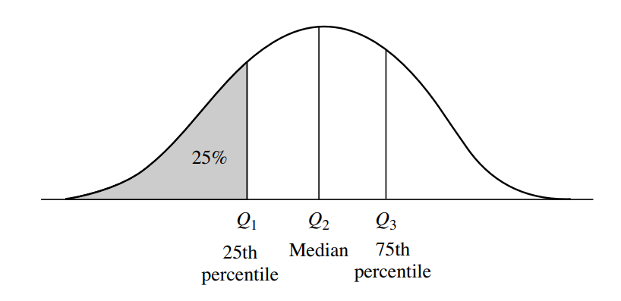
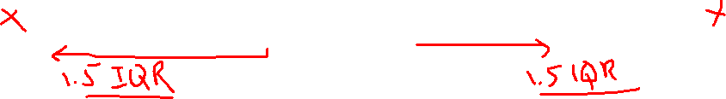
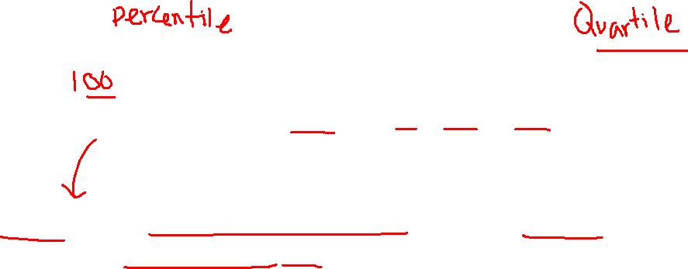
BASIC STATISTICAL DESCRIPTION OF DATA
Dispersion
Range The range of the set is the difference between the largest (max()) and smallest (min()) values.
Quantiles
Quantiles are points taken at regular intervals of a data distribution, dividing it into essentially equalsize consecutive sets. (We say “essentially” because there may not be data values of X that divide the data into exactly equal-sized subsets.
Notes:
Initially, the weights of the network are assigned random values, so the network merely implements a series of random transformations. Naturally, its output is far from what it should ideally be, and the loss score is accordingly very high. But with every example the network processes, the weights are adjusted a little in the correct direction, and the loss score decreases. This is the training loop, which, repeated a sufficient number of times (typically tens of iterations over thousands of examples), yields weight values that minimize the loss function.

Slide 22
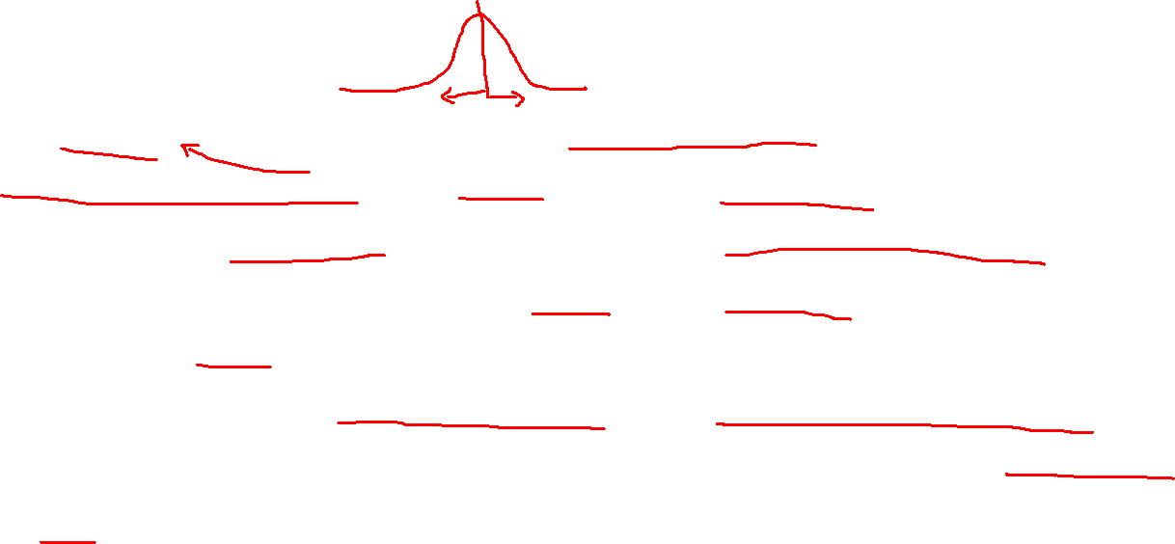
BASIC STATISTICAL DESCRIPTION OF DATA
Dispersion
Quartiles
The 2-quantile is the data point dividing the lower and upper halves of the data distribution. It corresponds to the median. The 4-quantiles are the three data points that split the data distribution into four equal parts; each part represents one-fourth of the data distribution. They are more commonly referred to as quartiles. The 100-quantiles are more commonly referred to as percentiles
The distance between the first and third quartiles is a simple measure of spread that gives the range covered by the middle half of the data. This distance is called the interquartile range (IQR) and is defined as
Notes:
Initially, the weights of the network are assigned random values, so the network merely implements a series of random transformations. Naturally, its output is far from what it should ideally be, and the loss score is accordingly very high. But with every example the network processes, the weights are adjusted a little in the correct direction, and the loss score decreases. This is the training loop, which, repeated a sufficient number of times (typically tens of iterations over thousands of examples), yields weight values that minimize the loss function.

Slide 23
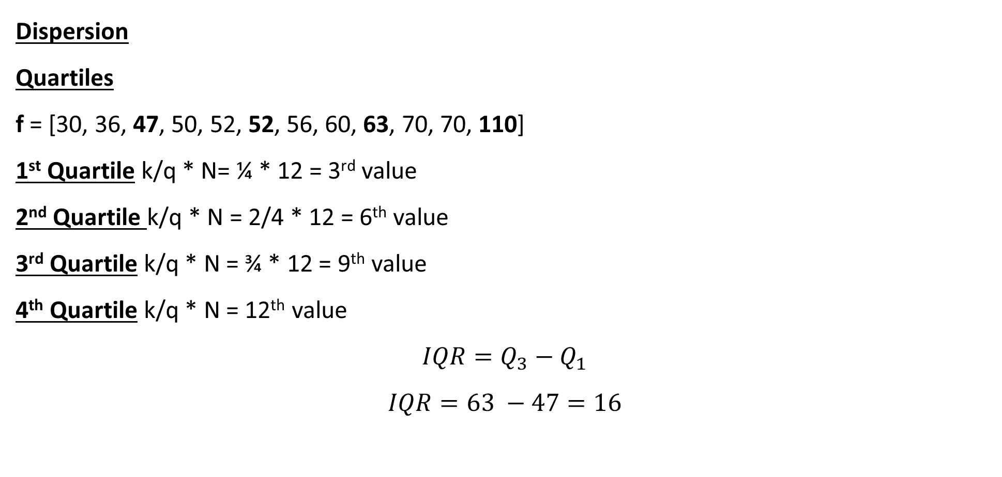
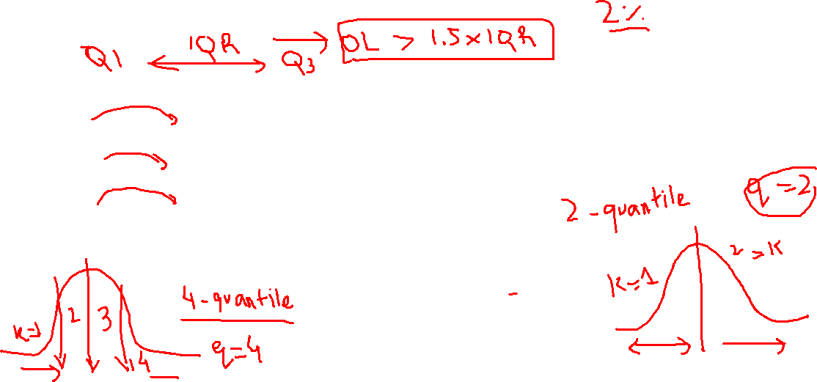
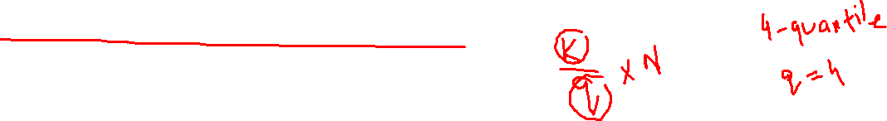
BASIC STATISTICAL DESCRIPTION OF DATA
Dispersion
Quartiles
f = [30, 36, 47, 50, 52, 52, 56, 60, 63, 70, 70, 110]
1st Quartile k/q * N= ¼ * 12 = 3rd value
2nd Quartile k/q * N = 2/4 * 12 = 6th value
3rd Quartile k/q * N = ¾ * 12 = 9th value
4th Quartile k/q * N = 12th value
$$IQR=Q_{3}−Q_{1}$$
$$IQR=63 −47=16$$
A common rule of thumb for identifying suspected outliers is to single out values falling at least 1.5 × IQR above the third quartile or below the first quartile
Notes:
Initially, the weights of the network are assigned random values, so the network merely implements a series of random transformations. Naturally, its output is far from what it should ideally be, and the loss score is accordingly very high. But with every example the network processes, the weights are adjusted a little in the correct direction, and the loss score decreases. This is the training loop, which, repeated a sufficient number of times (typically tens of iterations over thousands of examples), yields weight values that minimize the loss function.

Slide 24
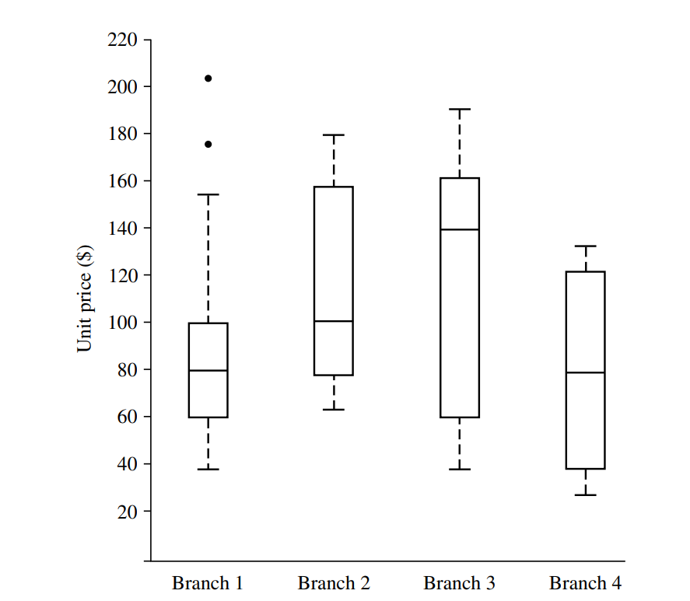
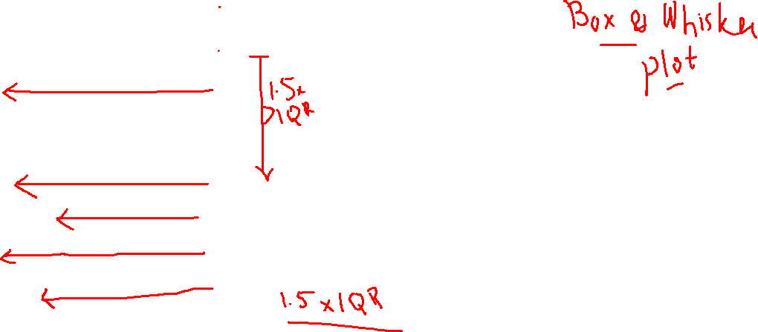
Understanding the Data First
Outliers
Max
Q3
Median
Q1
Minimum

Slide 25
PRAYERS BREAK till 2030 / 0830 PM

Slide 26
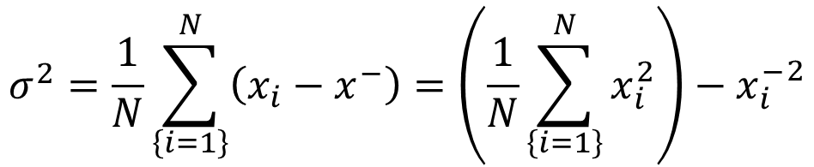
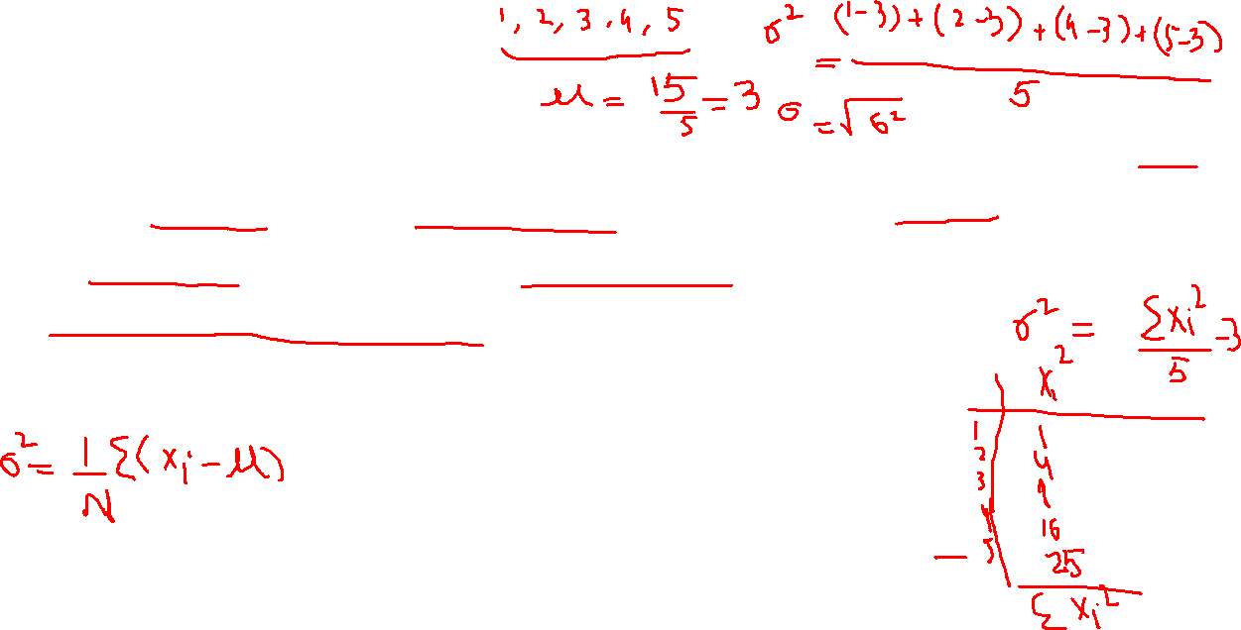
BASIC STATISTICAL DESCRIPTION OF DATA
Variance & Standard Deviation
Variance and standard deviation are measures of data dispersion. They indicate how spread out a data distribution is. A low standard deviation means that the data observations tend to be very close to the mean, while a high standard deviation indicates that the data are spread out over a large range of values.
The variance of N observations, x1,x2,...,xN , for a numeric attribute X is:
$$σ^{2}=\frac{1}{N}\sum_{\left\{i=1\right\}}^{N}{\left(x_{i}−x^{−}\right)=\left(\frac{1}{N}\sum_{\left\{i=1\right\}}^{N}{x_{i}^{2}}\right)−{x_{i}^{−}}^{2}}$$

Slide 27
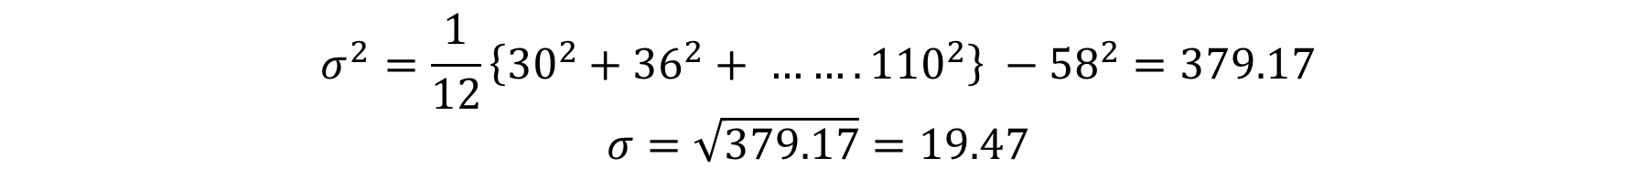
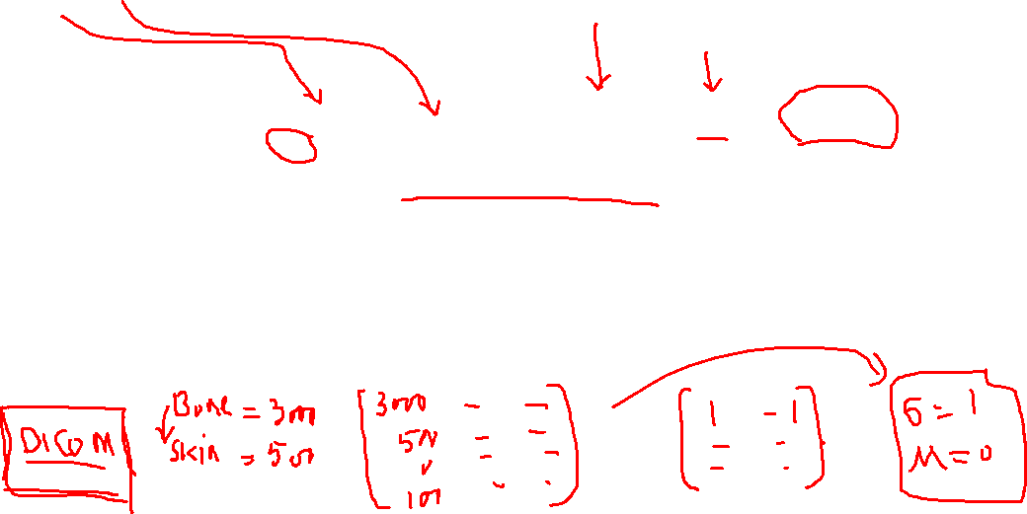
BASIC STATISTICAL DESCRIPTION OF DATA
f = [30, 36, 47, 50, 52, 52, 56, 60, 63, 70, 70, 110]
$$σ^{2}=\frac{1}{12}\left\{{30}^{2}+{36}^{2}+ ……. {110}^{2}\right\} −{58}^{2}=379.17$$
$$σ=\sqrt{379.17}=19.47$$
The basic properties of the standard deviation, σ, as a measure of spread are as follows: σ measures spread about the mean and should be considered only when the mean is chosen as the measure of center. σ = 0 only when there is no spread, that is, when all observations have the same value. Otherwise, σ > 0

Slide 28
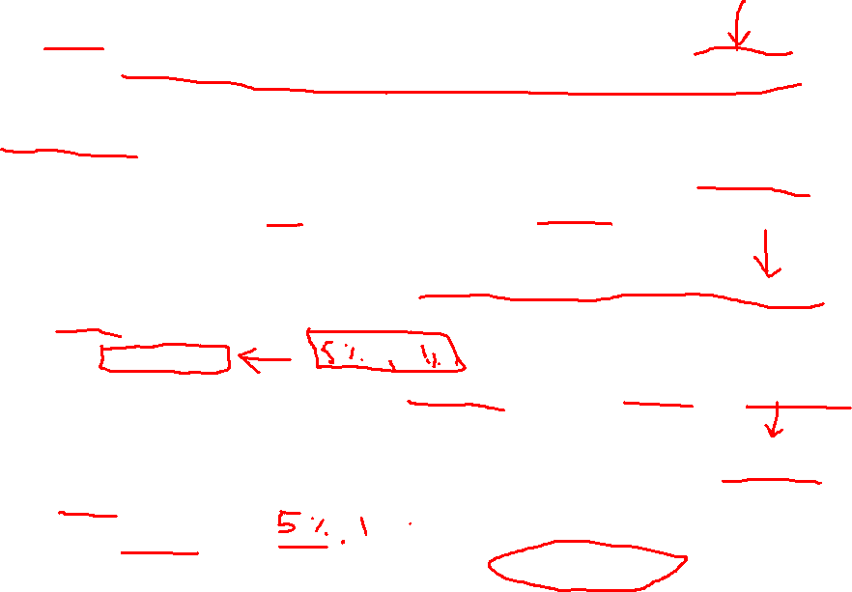
RECALL, PRECISION, ACCURACY, ROC
True Positive (TP):
Definition: The number of instances where the model correctly predicted the positive class.
Example: If a cancer detection model correctly identifies a patient with cancer, that's a true positive.
True Negative (TN):
Definition: The number of instances where the model correctly predicted the negative class.
Example: If the model correctly predicts a patient does not have cancer, that’s a true negative.
False Positive (FP):
Definition: The number of instances where the model incorrectly predicted the positive class (when it should have predicted negative).
Also known as: Type I Error.
Example: If the model incorrectly identifies a healthy patient as having cancer, it’s a false positive.
False Negative (FN):
Definition: The number of instances where the model incorrectly predicted the negative class (when it should have predicted positive).
Also known as: Type II Error.
Example: If the model incorrectly predicts that a patient does not have cancer when they actually do, it’s a false negative.

Slide 29
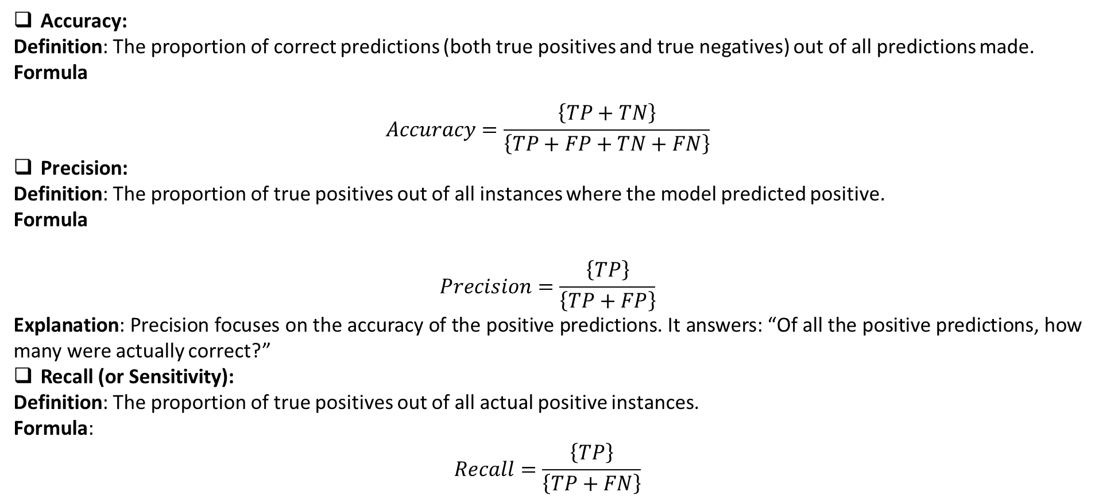
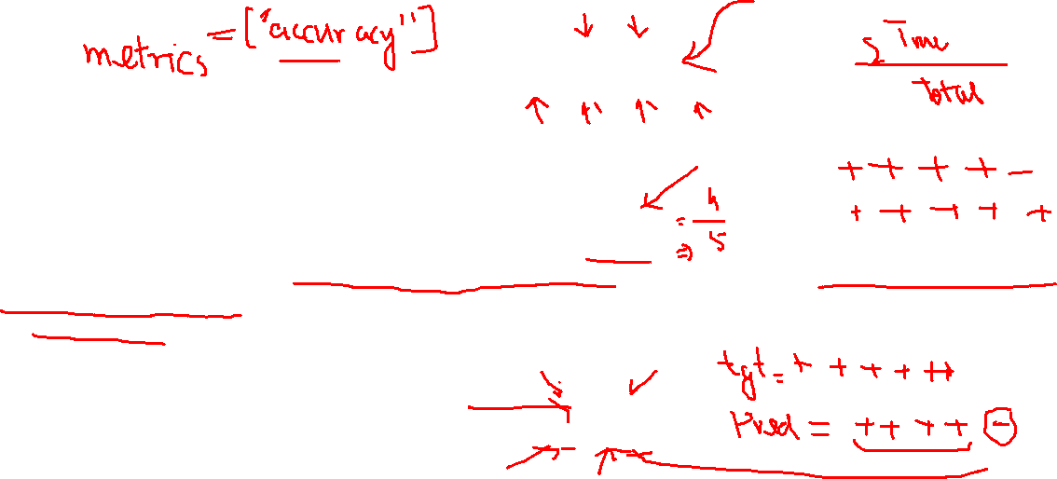
RECALL, PRECISION, ACCURACY, ROC
Accuracy:
Definition: The proportion of correct predictions (both true positives and true negatives) out of all predictions made.
Formula
$$Accuracy=\frac{\left\{TP+TN\right\}}{\left\{TP+FP+TN+FN\right\}}$$
Precision:
Definition: The proportion of true positives out of all instances where the model predicted positive.
Formula
$$Precision=\frac{\left\{TP\right\}}{\left\{TP+FP\right\}}$$
Explanation: Precision focuses on the accuracy of the positive predictions. It answers: “Of all the positive predictions, how many were actually correct?”
Recall (or Sensitivity):
Definition: The proportion of true positives out of all actual positive instances.
Formula:
$$Recall=\frac{\left\{TP\right\}}{\left\{TP+FN\right\}}$$

Slide 30
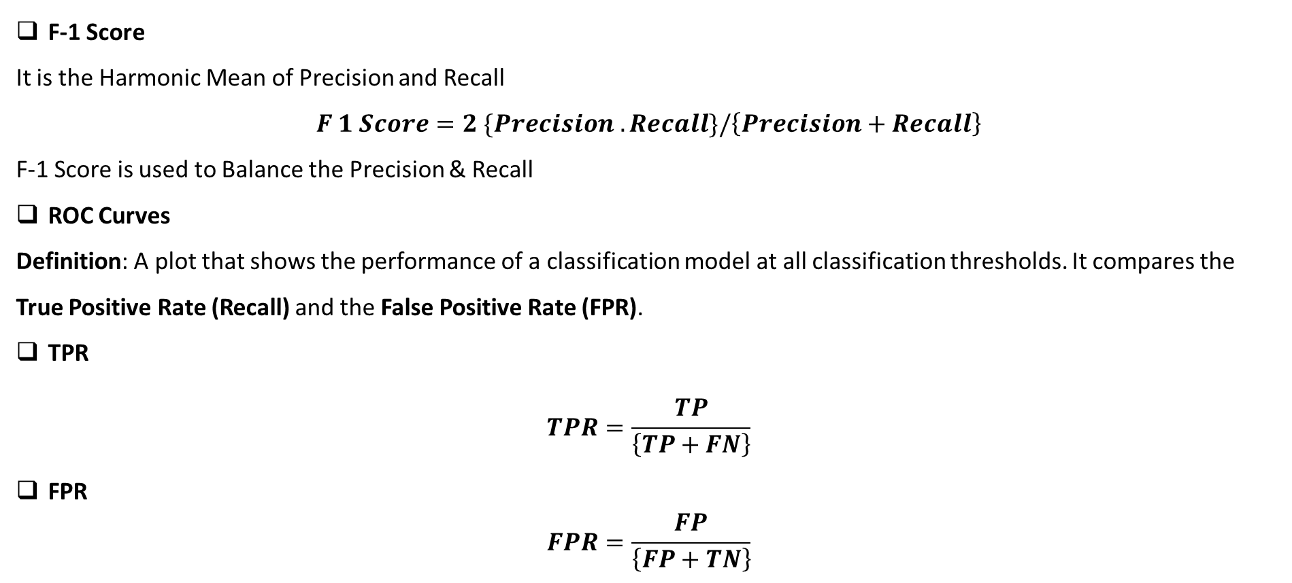
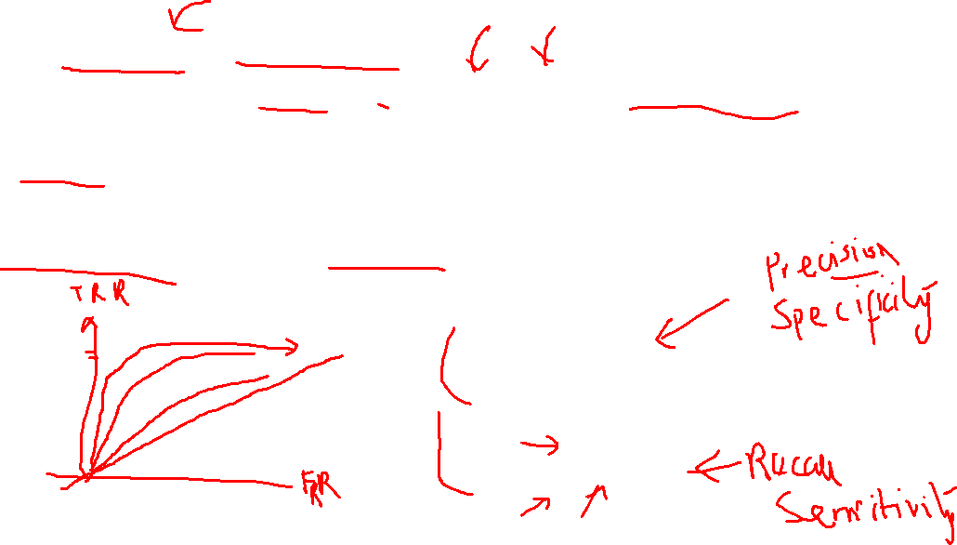
RECALL, PRECISION, ACCURACY, ROC
F-1 Score
It is the Harmonic Mean of Precision and Recall
$F 1 Score=2 \{Precision . Recall\}/\left\{Precision+Recall\right\}$
F-1 Score is used to Balance the Precision & Recall
ROC Curves
Definition: A plot that shows the performance of a classification model at all classification thresholds. It compares the True Positive Rate (Recall) and the False Positive Rate (FPR).
TPR
$$TPR=\frac{TP}{\left\{TP+FN\right\}}$$
FPR
$$FPR=\frac{FP}{\left\{FP+TN\right\}}$$

Slide 31
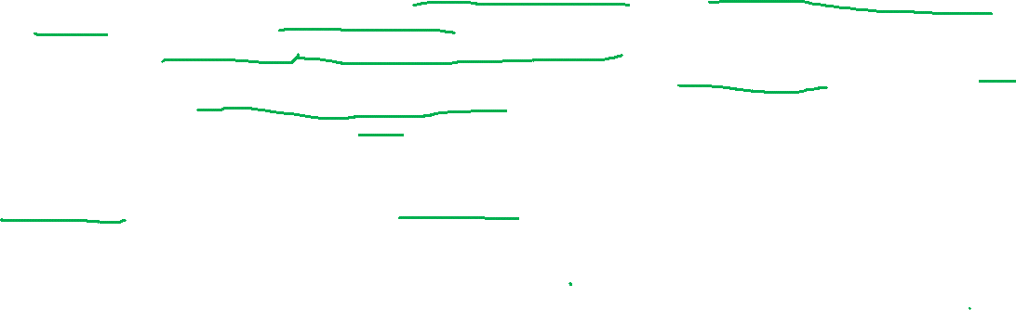
CONVOLUTIONAL NEURAL NETWORKS
Our entire review of machine learning and neural networks thus far have been leading up to this point: understanding Convolutional Neural Networks (CNNs) and the role they play in deep learning
In traditional feedforward neural networks , each neuron in the input layer is connected to every output neuron in the next layer – we call this a fullyconnected (FC) layer.
However, in CNNs, we don’t use FC layers until the very last layer(s) in the network.
We can thus define a CNN as a neural network that swaps in a specialized “convolutional” layer in place of “fully-connected” layer for at least one of the layers in the network
A nonlinear activation function, such as ReLU, is then applied to the output of these convolutions and the process of convolution => activation continues (along with a mixture of other layer types to help reduce the width and height of the input volume and help reduce overfitting) until we finally reach the end of the network and apply one or two FC layers where we can obtain our final output classifications
Each layer in a CNN applies a different set of filters, typically hundreds or thousands of them, and combines the results, feeding the output into the next layer in the network. During training, a CNN automatically learns the values for these filters.
In the context of image classification, our CNN may learn to:
• Detect edges from raw pixel data in the first layer.
• Use these edges to detect shapes (i.e., “blobs”) in the second layer.
• Use these shapes to detect higher-level features such as facial structures, parts of a car, etc. in the highest layers of the network.

